Slide 1
Lunch Sign Up Program

Slide 2
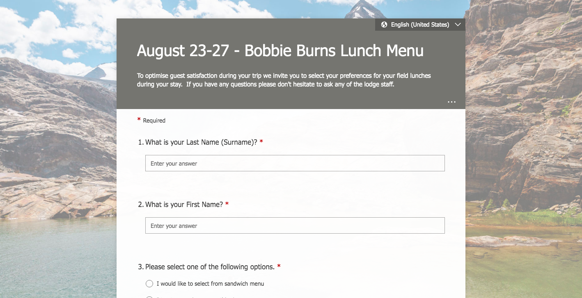
Objective:
To create an opportunity for guests to select their field lunch preferences using an electronic form.

Slide 3
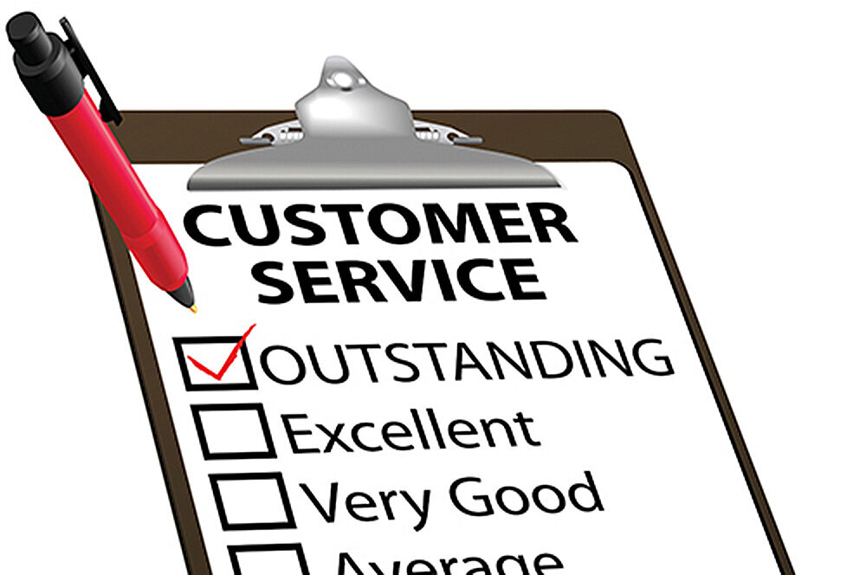
Why?
To build on our excellent guest service objectives and to offer more choice.
To eliminate high touch points (clipboard/pens) and keeping track of multiple sheets of paper.

Slide 4
How?
Using Microsoft Forms App
Using Short.io URL Forwarding Service
Who?
Form will be created in each lodge
First Cooks will make a new Form for each trip
Lodge Management will update the link on the in-lodge website each trip.

Slide 5
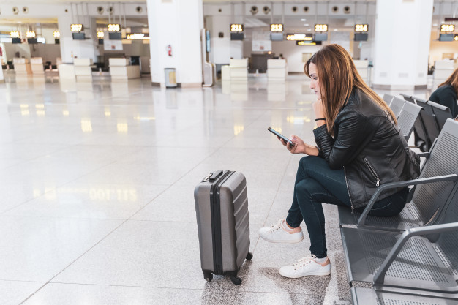
When?
The day before incoming guests arrive at lodge
CMH Coach Hosts will prompt and assist guests en route to lodge
Lodge Management will prompt and assist guests at lodge

Slide 6
Benefits:
Professional and efficient
Improve control of food waste
Reduces high touch points
Challenges:
Guest Participation – will they fill out the form?
Different approach in menu planning for returning culinary staff
Too many QR codes?

Slide 7
Roll Out:
Piloted the program at Bobbie Burns this past summer
Introduce program and train culinary teams at Hospitality Trainings 2021
Company wide implementation for Winter 2021/22
Feedback?

Slide 8
Thank You!!

